Slide 1
AI for the legal domain: an explainability challenge
PhD SRC @ IFIP WCC 2018 (extended)
Alexandre Quemy
IBM
Politechnika Poznańska
Supervisor: Pr. Wrembel

Slide 2
Article invited into:
Foundations of Computing and Decision Sciences
(15 points)
Notes:
As a result, text seems to be a better predictor than (engineered) features + some features are hard to estimate

Slide 3
Context of Legal Analytics

Slide 4
The main problem
Legal analytics:
Problem:
Need of legal justification.
Predictive power mostly holds... in non legal factors.
The idea: make a prediction with a global model, then build a local legal justification
Additional challenges:
Complex rules: hard to extract estimators, exception, grey areas...
Non-monotonic reasonings
Non-stationarity and brutal invalidation of past decisions
Many sources of information
...
Notes:
As a result, text seems to be a better predictor than (engineered) features + some features are hard to estimate

Slide 5
Context
An example:
European Union directive to set fines for abuses of dominant position:
“The level of a fine must be sufficiently high both to punish the firms involved and to deter others from practices that infringe the competition rules. [...] The basic amount is calculated as a percentage of the value of the sales connected with the infringement [...]. The percentage of the value of sales is determined according to the gravity of the infringement (nature, combined market share of all the parties concerned, geographic scope, etc.) and may be as much as 30 %.”

Slide 6
Why does it matter?
The size of the justice system:
In United States:
1,300,000 licensed attorneys in the United States.
58 million consumers in the U.S. sought an attorney.
200 law schools
In France:
60000 lawyers, +41% in 10 years
in 2014, 791.448 basic missions for juridical help.
8355 judges
50 law universities

Slide 7
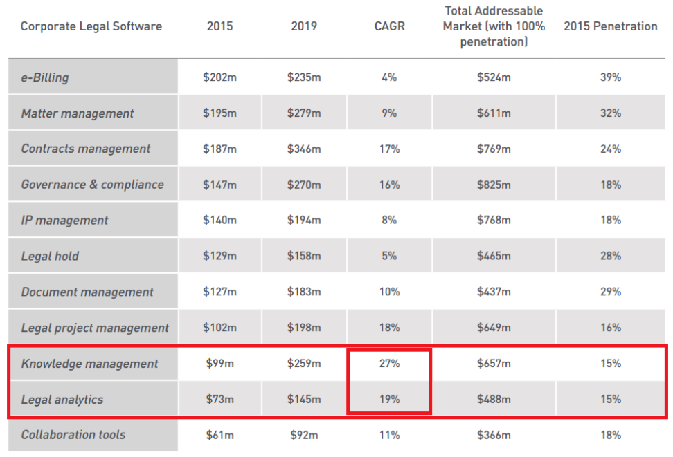
Why does it matter?
From a business perspective:

Slide 8
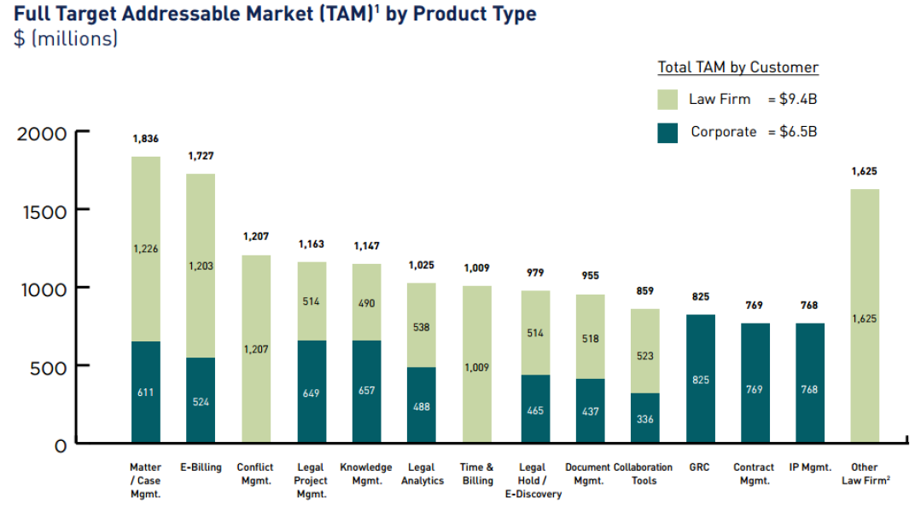
Context
From a business perspective:

Slide 9
Context
Legal analysis:
Predicting and understanding justice decisions
First approach: Case-Based Reasoning and Expert Systems
Advantages:
Good at providing explanation
Drawbacks:
Use only legal arguments ~ bad at prediction
Often hardcoded with limited knowledge and rigid structure

Slide 10
Context
Legal analysis:
Predicting and understanding justice decisions
Second Approach: Data-Driven methods
Advantages:
Good at prediction
No hardcoded domain
Drawbacks:
Cannot produce legal justification
Needs a lot of examples / data
Ref: Data Science Techniques for Law and Justice: Current State of Research
and Open Problems, Alexandre Quemy, ADBIS 2017

Slide 11
AGENDA
Introduction to Legal Analytics Phase 1. – Prediction problem
→ Hypergraph Case Based Reasoning → European Court of Human Rights Open Data → Prediction of the ECHR decisions
Phase 2. – Justification problem
→ Direct justification with HCBR → Graph reconstruction using HCBR and CSP
→ Generating explanation for the ECHR decisions
Summary and Future Plans

Slide 12
The doctoral project in one picture
Data
ML
UCI datasets
HCBR
Justification Trees
Small ECHR
Standard methods
Graph Reconstruction
ECHR-OD
Phase 1. Prediction
Phase 2. Justification

Slide 13
The doctoral project in one picture
Data
ML
UCI datasets
HCBR
Justification Trees
Small ECHR
Standard methods
Graph Reconstruction
ECHR-OD
Phase 1. Prediction
Phase 2. Justification

Slide 14
Phase 1. − Prediction
→ Hypergraph Case Based Reasoning

Slide 15
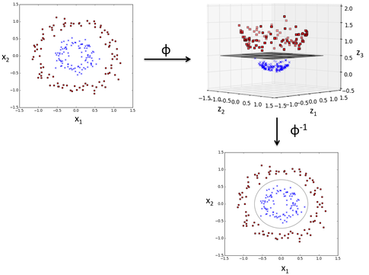
Prediction - HCBR
On the necessity of Unstructured Spaces:
No inner product or embedded metric with the input vector space
Notes:
Most of classification methods work directly in the feature space, or, when
they modify it, the resulting space inherits the topology of the initial space.
In the particular case of linear models, a scalar product is mandatory to
represent the decision itself and to quantify the distance from an element to
the decision boundary. In some cases, a metric is obviously available, and
in some other cases some ad-hoc metrics may be constructed for a specific
problem.
However, there a plenty of practical situations where the good
metric is not known (e.g. it requires a very specific expertise). Also, it is
very common to miss some data in a dataset (e.g. due to a defective sensor
for some period of time), or to have to include new pieces of information
after an initial model was built (e.g. adding new sensors). In the case of
SVM, for instance in R 3 , if an element has only 2 components it does not
describe a point but a plan and as a result, there is no way separate it with a
(hyper)plan.
Conversely, consider a model built in R 2 with some additional information
available after such that the classification instance now lives in R 3 . Math-
ematically, there is no guarantee that the model in two dimensions is even
close to the model built from scratch in three dimensions. For instance, if the
points are not linearly separable in two dimensions but are in three dimen-
sions, there is no chance for the projection of the plane into the subspace of
two dimensions to be the model found while working only in this subspace.
Despite multiple algorithms have an online counterpart, i.e. the model keeps
being trained with new input vectors, as far as we know, there is no significant
work on having this horizontal scalability (as opposed to vertical scalability).
Of course, exploiting the specificities of features often
6lead to better results but also requires manual expertise that blocks a wider
adoption by end-users. This is particularely true with categorical variables
that often require to be encoded taking into account the method specificity.
For instance, for Decision Tree and its Ensemble counterpart, the Random
Forest, the accuracy depends on the encoder and using a Numerical encoder,
a One-Hot encoder or a Binary encoder may drastically change the model
fitted on the same data. For this reason, it is also important to develop
methods that are “agnostic” to the data representation or at least as less
sensitive as possible.

Slide 16
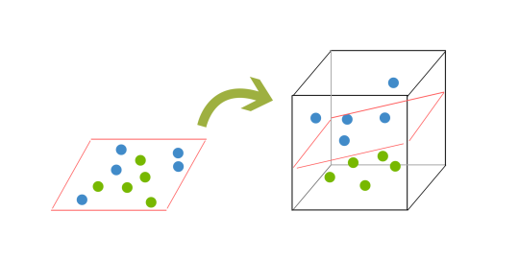
Prediction - HCBR
On the necessity of Unstructured Spaces:
No assumption on the input „vector” cardinality (incomplete systems, BoW)
Notes:
Most of classification methods work directly in the feature space, or, when
they modify it, the resulting space inherits the topology of the initial space.
In the particular case of linear models, a scalar product is mandatory to
represent the decision itself and to quantify the distance from an element to
the decision boundary. In some cases, a metric is obviously available, and
in some other cases some ad-hoc metrics may be constructed for a specific
problem.
However, there a plenty of practical situations where the good
metric is not known (e.g. it requires a very specific expertise). Also, it is
very common to miss some data in a dataset (e.g. due to a defective sensor
for some period of time), or to have to include new pieces of information
after an initial model was built (e.g. adding new sensors). In the case of
SVM, for instance in R 3 , if an element has only 2 components it does not
describe a point but a plan and as a result, there is no way separate it with a
(hyper)plan.
Conversely, consider a model built in R 2 with some additional information
available after such that the classification instance now lives in R 3 . Math-
ematically, there is no guarantee that the model in two dimensions is even
close to the model built from scratch in three dimensions. For instance, if the
points are not linearly separable in two dimensions but are in three dimen-
sions, there is no chance for the projection of the plane into the subspace of
two dimensions to be the model found while working only in this subspace.
Despite multiple algorithms have an online counterpart, i.e. the model keeps
being trained with new input vectors, as far as we know, there is no significant
work on having this horizontal scalability (as opposed to vertical scalability).
Of course, exploiting the specificities of features often
6lead to better results but also requires manual expertise that blocks a wider
adoption by end-users. This is particularely true with categorical variables
that often require to be encoded taking into account the method specificity.
For instance, for Decision Tree and its Ensemble counterpart, the Random
Forest, the accuracy depends on the encoder and using a Numerical encoder,
a One-Hot encoder or a Binary encoder may drastically change the model
fitted on the same data. For this reason, it is also important to develop
methods that are “agnostic” to the data representation or at least as less
sensitive as possible.

Slide 17
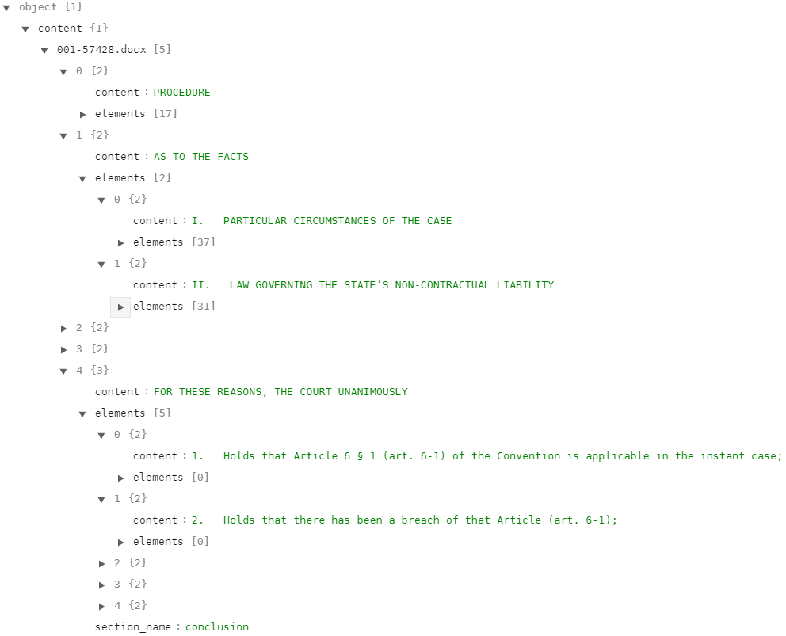
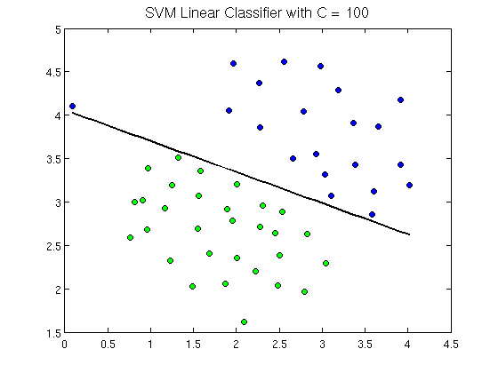
Prediction - HCBR
On the necessity of Unstructured Spaces:
No assumption on the concrete representation of features
versus
Notes:
Most of classification methods work directly in the feature space, or, when
they modify it, the resulting space inherits the topology of the initial space.
In the particular case of linear models, a scalar product is mandatory to
represent the decision itself and to quantify the distance from an element to
the decision boundary. In some cases, a metric is obviously available, and
in some other cases some ad-hoc metrics may be constructed for a specific
problem.
However, there a plenty of practical situations where the good
metric is not known (e.g. it requires a very specific expertise). Also, it is
very common to miss some data in a dataset (e.g. due to a defective sensor
for some period of time), or to have to include new pieces of information
after an initial model was built (e.g. adding new sensors). In the case of
SVM, for instance in R 3 , if an element has only 2 components it does not
describe a point but a plan and as a result, there is no way separate it with a
(hyper)plan.
Conversely, consider a model built in R 2 with some additional information
available after such that the classification instance now lives in R 3 . Math-
ematically, there is no guarantee that the model in two dimensions is even
close to the model built from scratch in three dimensions. For instance, if the
points are not linearly separable in two dimensions but are in three dimen-
sions, there is no chance for the projection of the plane into the subspace of
two dimensions to be the model found while working only in this subspace.
Despite multiple algorithms have an online counterpart, i.e. the model keeps
being trained with new input vectors, as far as we know, there is no significant
work on having this horizontal scalability (as opposed to vertical scalability).
Of course, exploiting the specificities of features often
6lead to better results but also requires manual expertise that blocks a wider
adoption by end-users. This is particularely true with categorical variables
that often require to be encoded taking into account the method specificity.
For instance, for Decision Tree and its Ensemble counterpart, the Random
Forest, the accuracy depends on the encoder and using a Numerical encoder,
a One-Hot encoder or a Binary encoder may drastically change the model
fitted on the same data. For this reason, it is also important to develop
methods that are “agnostic” to the data representation or at least as less
sensitive as possible.

Slide 18
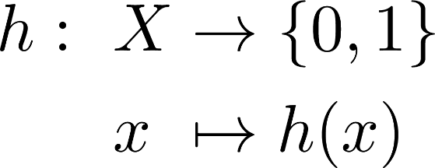
Binary Classification problem
Classical formulation:
In practice, ML algorithm select or build h from a model-space H made of restrictions or hypothesis on the „shape” of h based on the data.

Slide 19
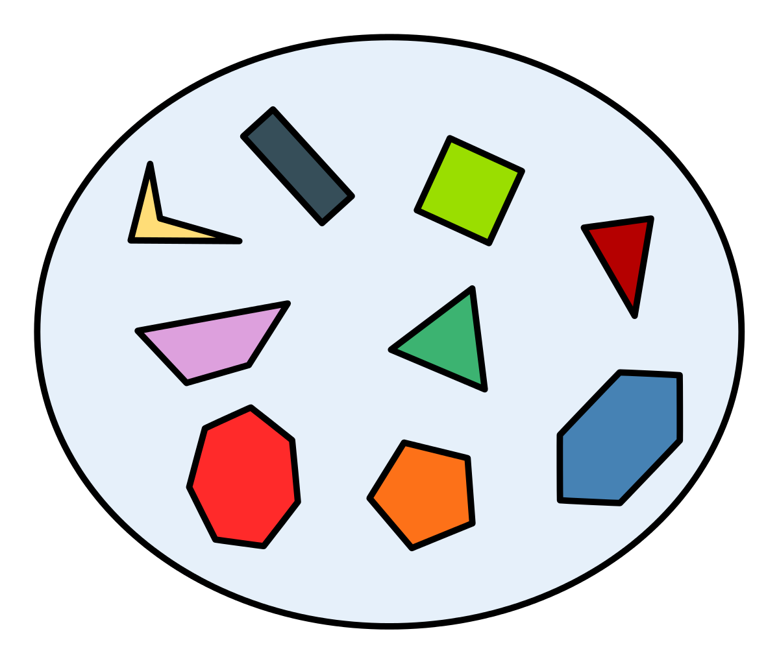
Binary Classification problem
Formulation:
Work Hypothesis: countable (finite) space and
Notes:
The abstract space can be a database, something not structured, well-structured, etc. It is not our matter here. Contrary to the initial formulation, the input vector space is not defined, can miss some elements, etc. You also do not need any metric or scalar product contrary to many other approach like SVM.
In practice, it is likely that only a subset of P may appear (e.g. Two contradictory proposition encoded by two elements of F)

Slide 20
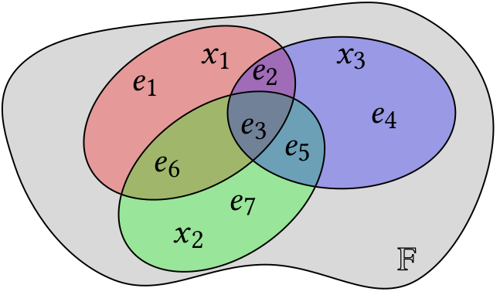
Hypergraph Case-Based Reasoning
e1
income=10k
loves dogs
Notes:
Hypergraph is a generalization of a graph (2 vertices per edge)
A subhypergraph is like a „windows” on the the hypergraph.
E is a partition of V_X and e is a set of features, not a single feature.

Slide 21
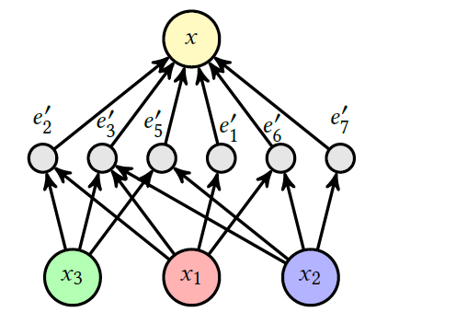
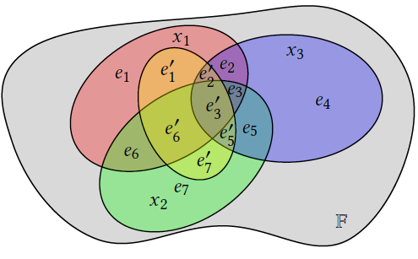
Hypergraph representation
A bit more of definitions:

Slide 22
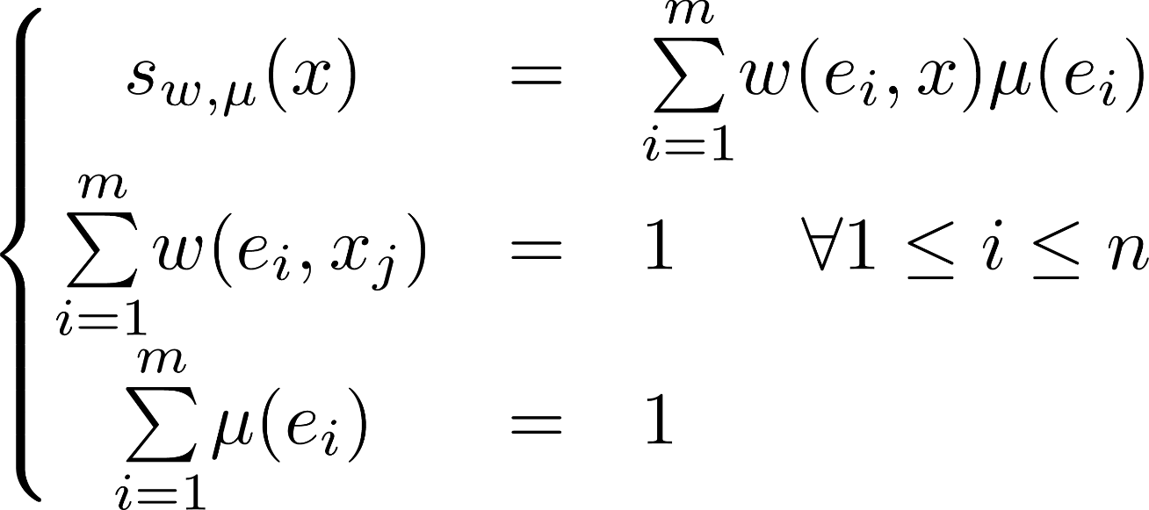
Model Space and Model Selection
Model Space:
Support
Importance of e in x
Intrinsic strength of e w.r.t. H
Notes:
Well, very large model space, product of two functional spaces. Advantage: no assumption on \mathbf F: works for incomplete systems, non-metric space, non-homogeneous space.
One big hypothesis is that if two cases are not sharing any features, they are independant in the sense they cannot help to understand each other or support.

Slide 23
Model Space and Model Selection
Model Space:
Support
Importance of e in x
Intrinsic strength of e w.r.t. H
Notes:
Well, very large model space, product of two functional spaces. Advantage: no assumption on \mathbf F: works for incomplete systems, non-metric space, non-homogeneous space.
One big hypothesis is that if two cases are not sharing any features, they are independant in the sense they cannot help to understand each other or support.

Slide 24
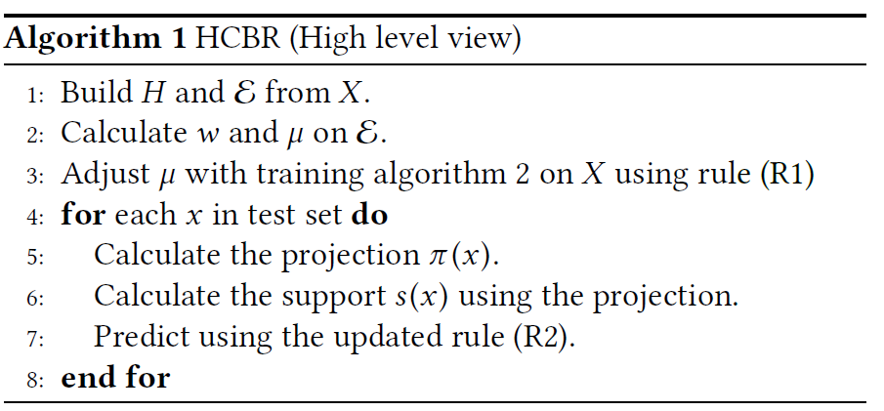
Model Space and Model Selection
Hypergraph Case-Based Reasoning:
Notes:
Well, very large model space, product of two functional spaces. Advantage: no assumption on \mathbf F: works for incomplete systems, non-metric space, non-homogeneous space

Slide 25
Model Space and Model Selection
Model Selection:

Slide 26
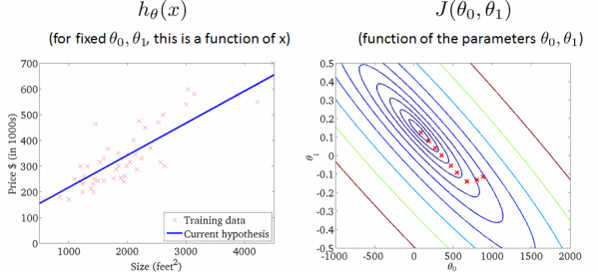
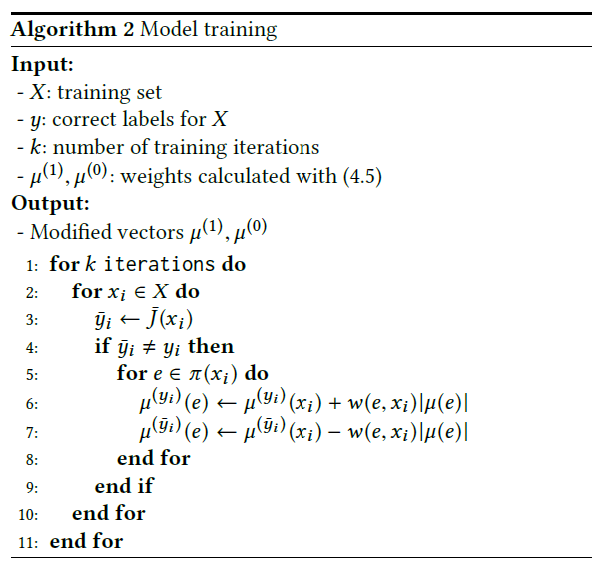
Model Training
Objective: Minimizing a sort of Hinge-loss
Stochastic Gradient Descent (sort of)
Notes:
But it is not enough. As the partition element represents some probabilities or likelihood,

Slide 27
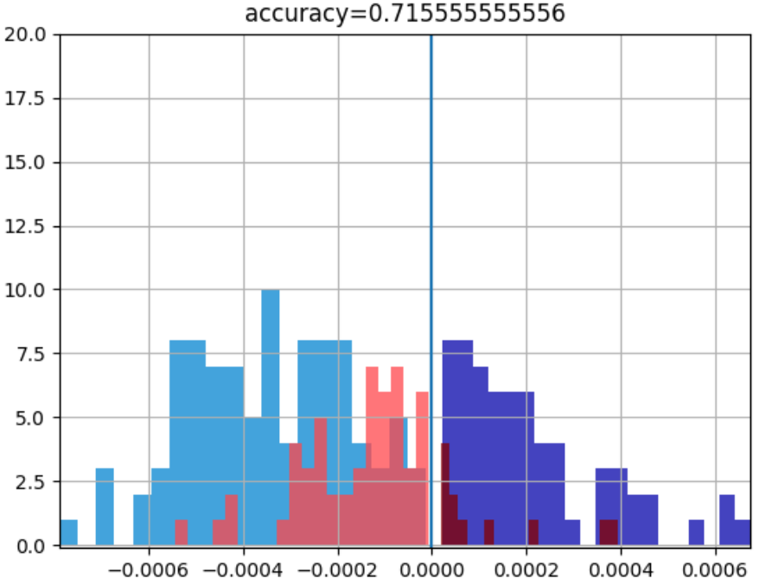
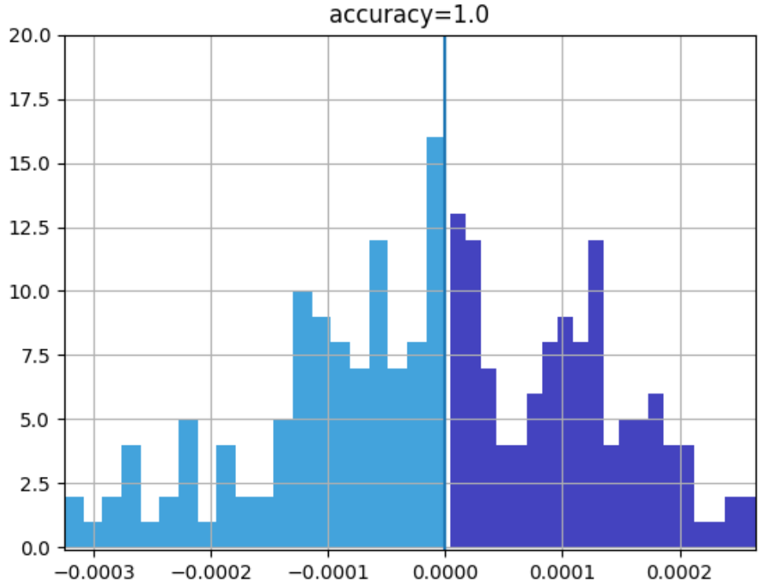
Model Training
Text classification
Notes:
But it is not enough. Brin As the partition element represents some probabilities or likelihood,

Slide 28
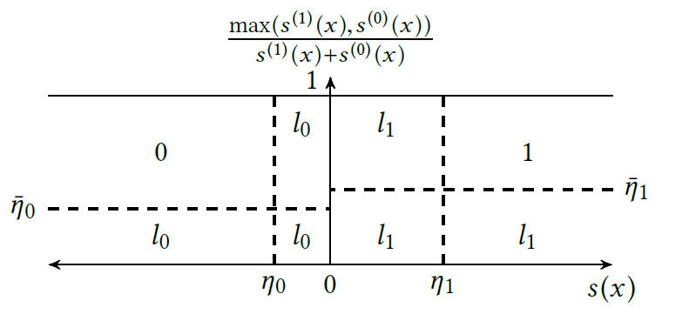
Prediction
Updated classification rule:
Notes:
The idea is to control how much evidence we need, either absolute quantity, or compared to the support toward the other class.

Slide 29
Prediction
Updated classification rule:
Notes:
The idea is to control how much evidence we need, either absolute quantity, or compared to the support toward the other class.

Slide 30
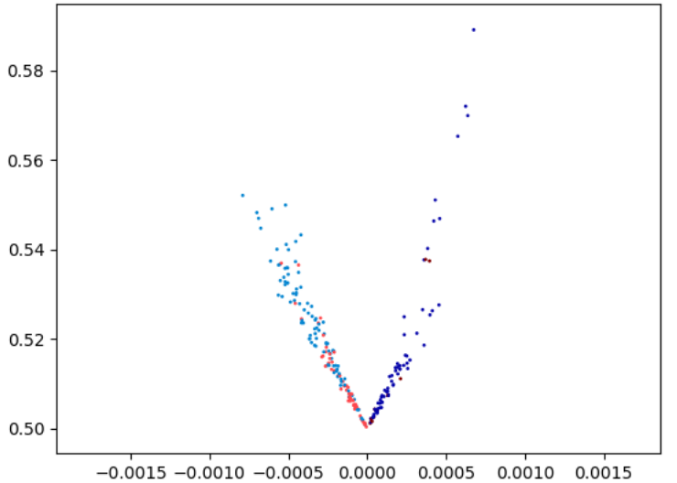
Prediction
0
1
1
0
Notes:
The idea is to control how much evidence we need, either absolute quantity, or compared to the support toward the other class.

Slide 31
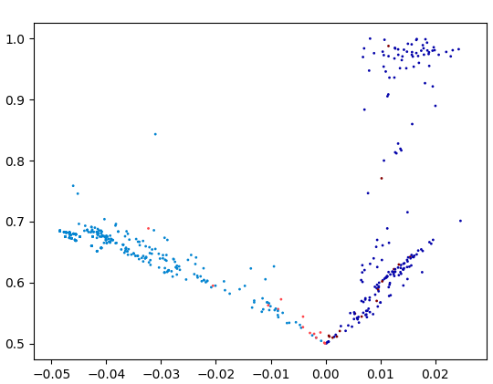
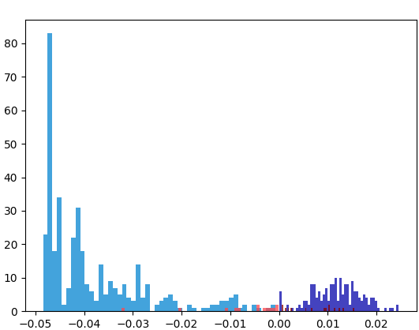
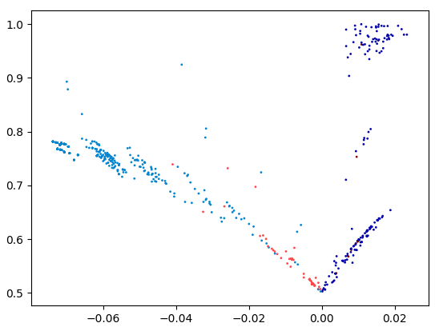
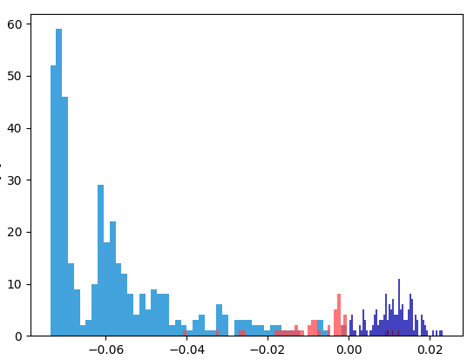
Prediction
Notes:
The idea is to control how much evidence we need, either absolute quantity, or compared to the support toward the other class.

Slide 32
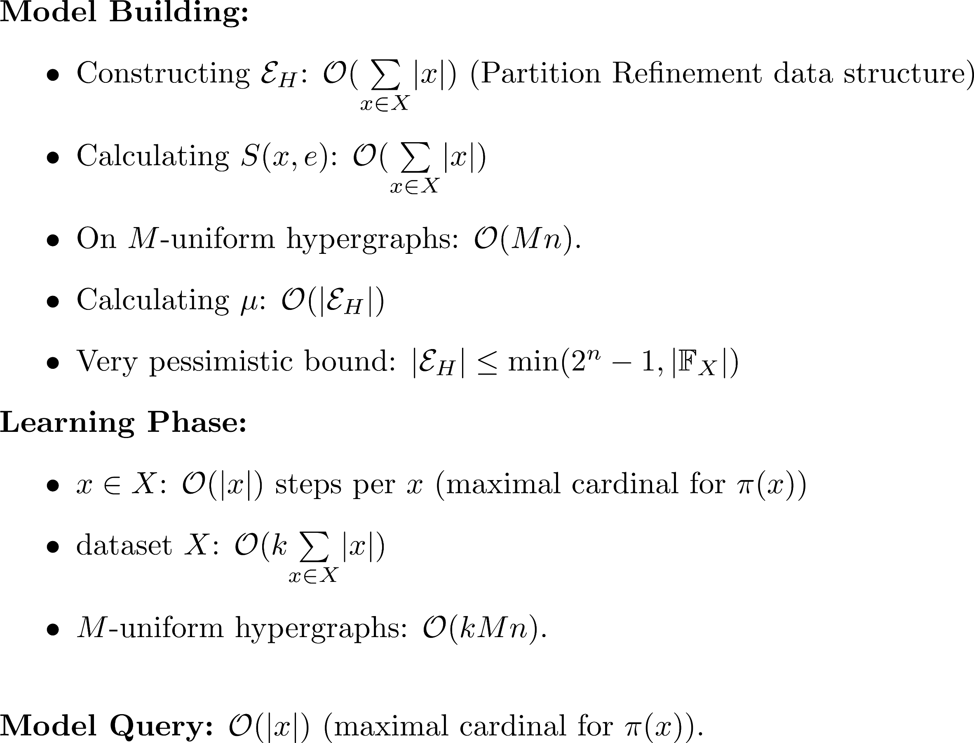
Complexity
Notes:
A video is a temporal signal on a time interval

Slide 33
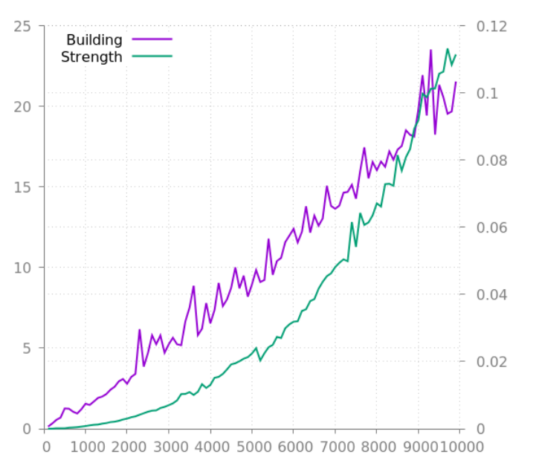
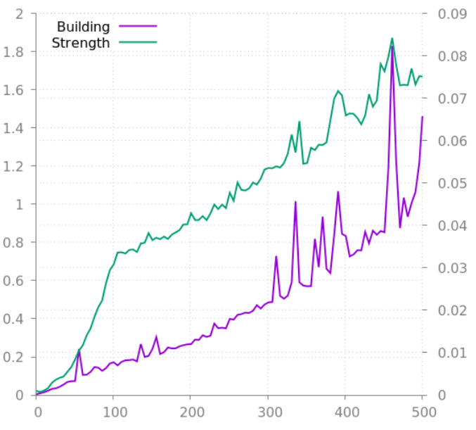
Complexity
In practice:
Strength
Building
Depending on n (m = 10)
Depending on m (n = 100)
Notes:
The case i is described by i, i+m such that each input vector is partitionned into m elements.

Slide 34
Experiments and Results

Slide 35
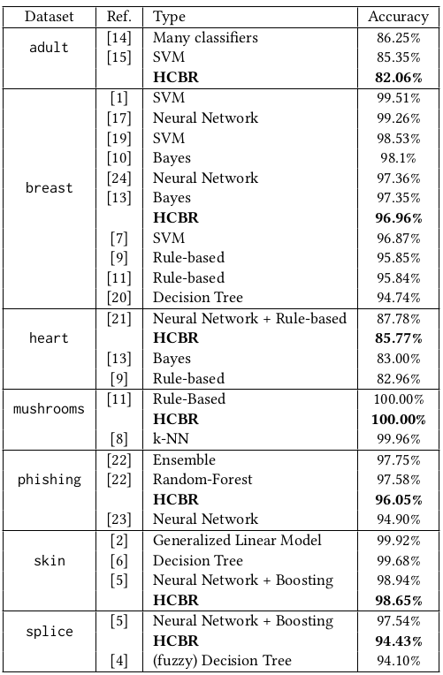
Experiments and Results
Protocol: 10 fold cross-validation, no metaparameter tuning (only training)
Contrary to the state-of-art, no assumption, no
ad-hoc feature selection or transformation.
Notes:
A video is a temporal signal on a time interval

Slide 36
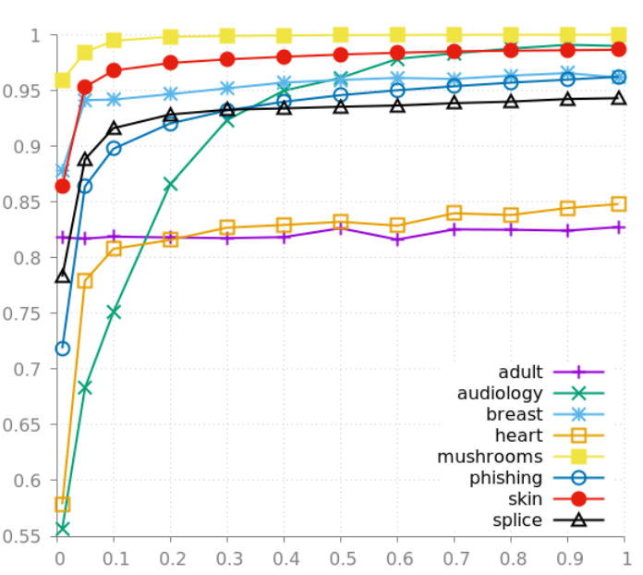
Classification problem
Very few examples needed + does not overfit:
Accuracy
Training set size (%)
Notes:
Actually, maybe it does underfit for adult or heart to be honest.

Slide 37
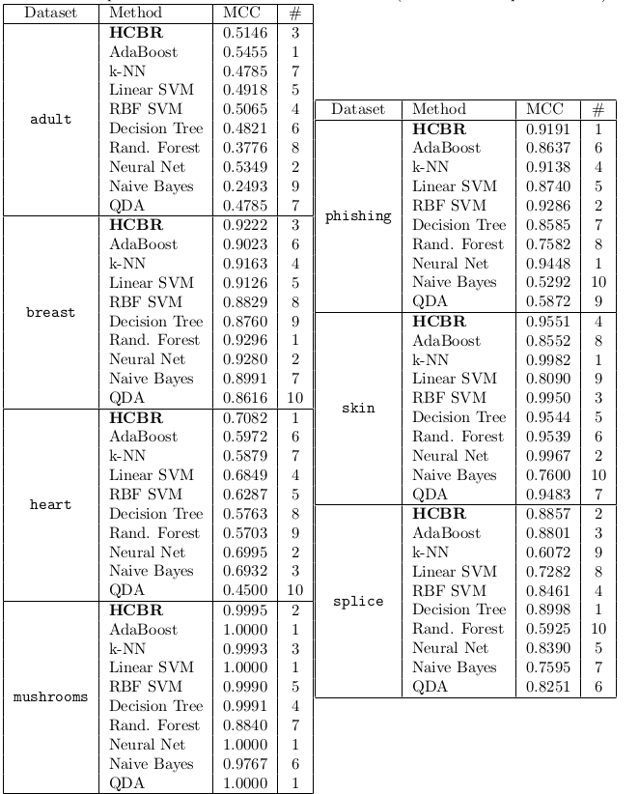
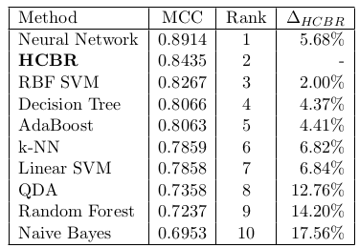
Classification problem
Notes:
Actually, maybe it does underfit for adult or heart to be honest.

Slide 38
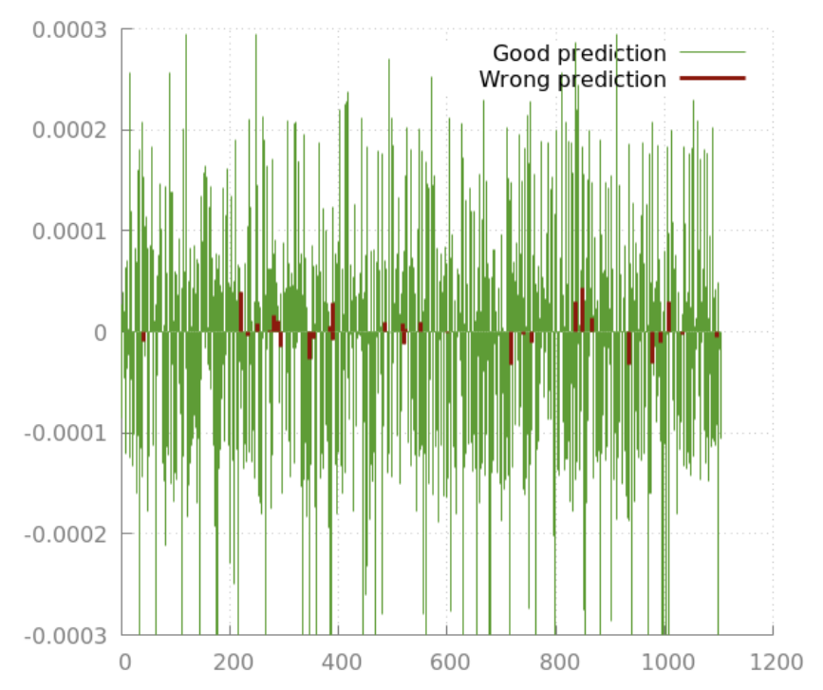
Experiments and Results
Confidence measure:
Notes:
A video is a temporal signal on a time interval

Slide 39
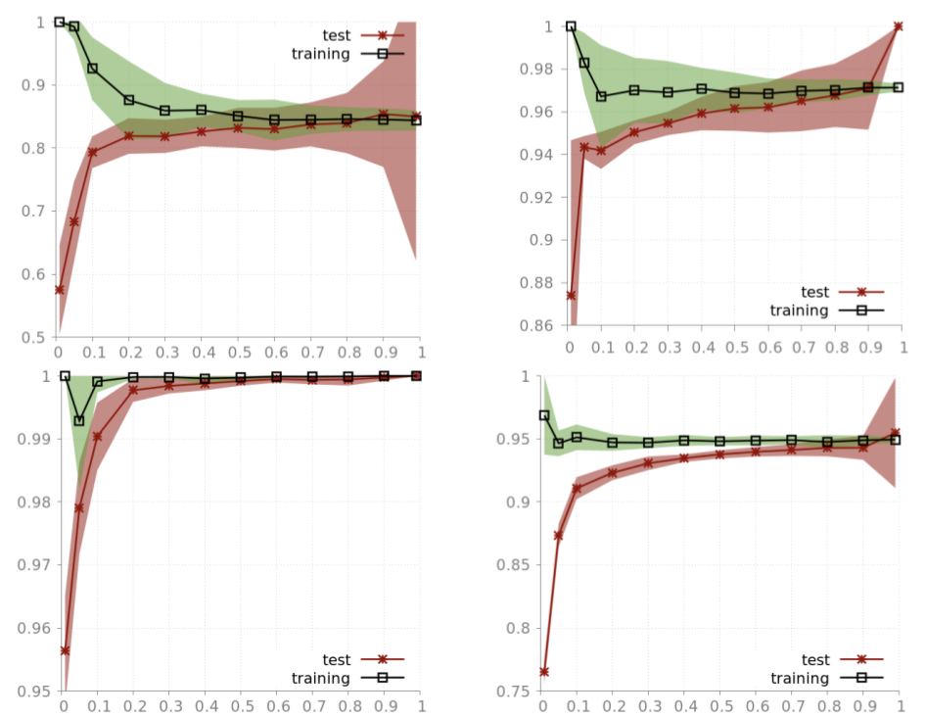
Improvements, WIP and future work
Problem with bias:
Notes:
It seems that what prevents HCBR to obtain good results on adult dataset for instance is the „expressivity” or „model complexity” we defined.

Slide 40
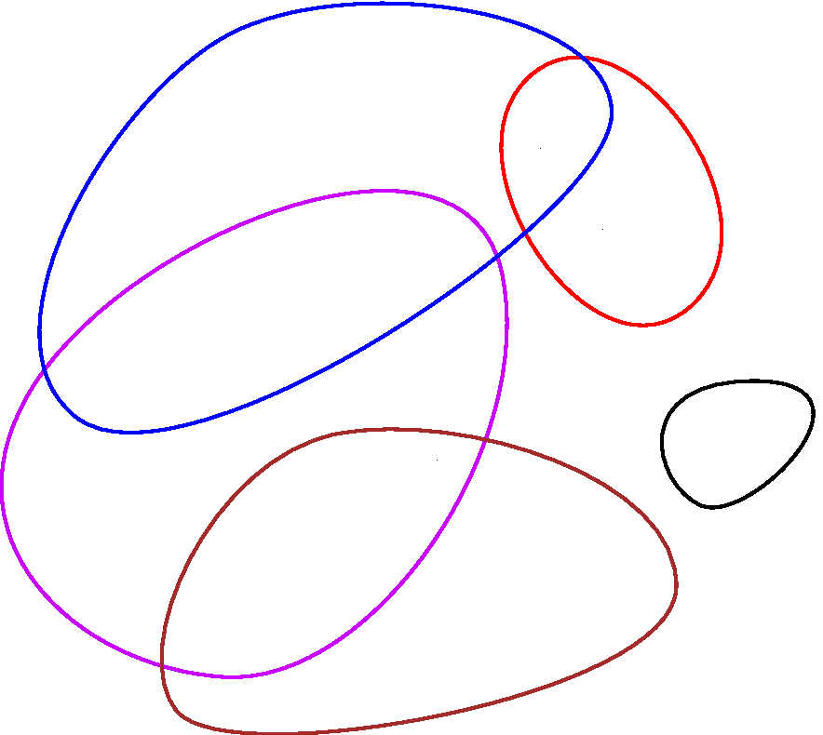
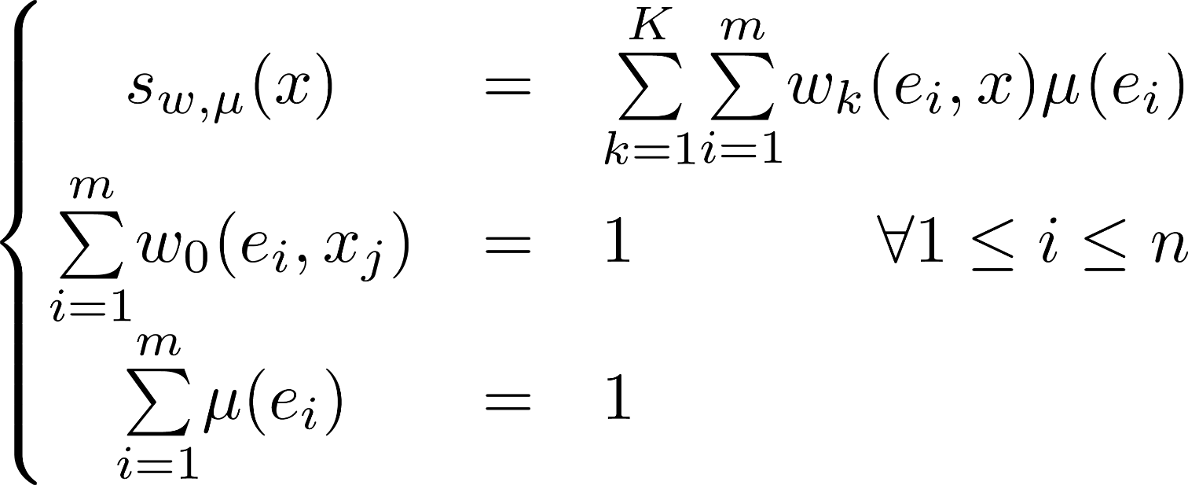
Improvements, WIP and future work
Model Space extension:
Notes:
It seems that what prevents HCBR to obtain good results on adult dataset for instance is the „expressivity” or „model complexity” we defined.

Slide 41
Improvements, WIP and future work
Multiclass and multilabel support:
Straigthforward time-linear extension of mu
Fully online and scalable version:
Online: Semi-online: training after each decision but the input vector not added to the hypergraph Fully online: new hyperedge, then weights adjustment
Vertical and horizontal scalability:
Vertical: adding more cases (i.e. fully online) Horizontal: add more atoms to some cases without starting from scratch
Notes:
Well, very large model space, product of two functional spaces. It seems that what prevents HCBR to obtain good results on adult dataset for instance is the „expressivity” or „model complexity” we defined.

Slide 42
Article invited into:
Information Systems by Elsevier
(35 points)
Need to be revised. But very nice comments:
"[...] I would say that this paper achieves a level of mathematical justification that I have rarely observed in computer sciences papers."
Notes:
It seems that what prevents HCBR to obtain good results on adult dataset for instance is the „expressivity” or „model complexity” we defined.

Slide 43
Phase 1. − Prediction
→ European Court of Human Rights Open Data

Slide 44
European Court of Human Rights Open Data Project
Core values: Reusability, quality and availibility
In practice:
Everything is carefully versioned and publicly available.
The process and files produced are careful documented.
Open-source scripts from scratch.
No data is manipulated by hand.
https://echr-opendata.eu
Notes:
Database and dataset not available online yet (article being written and read before)
Everything = generation process scripts
+ intermediary
-> reproducibility and trust

Slide 45
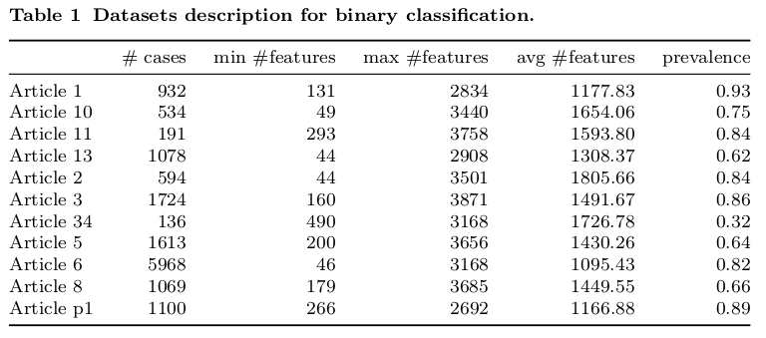
European Court of Human Rights Open Data Project
Case filters:
only cases in english
only cases with a judgement document
only the cases with a clear conclusion (i.e. containing at least one occurrence of “(no) violation”),

Slide 46
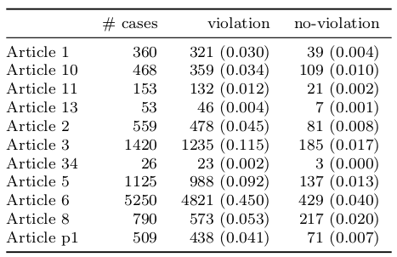
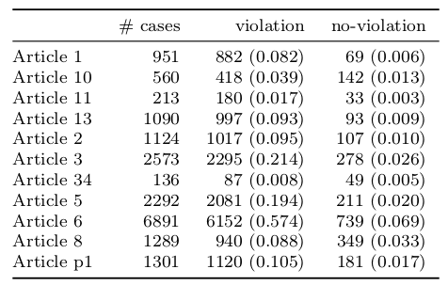
European Court of Human Rights Open Data Project

Slide 47
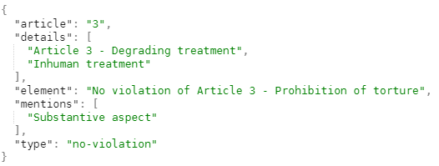
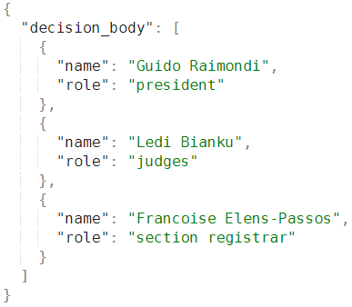
European Court of Human Rights Open Data Project
Extract from a processed document:

Slide 48
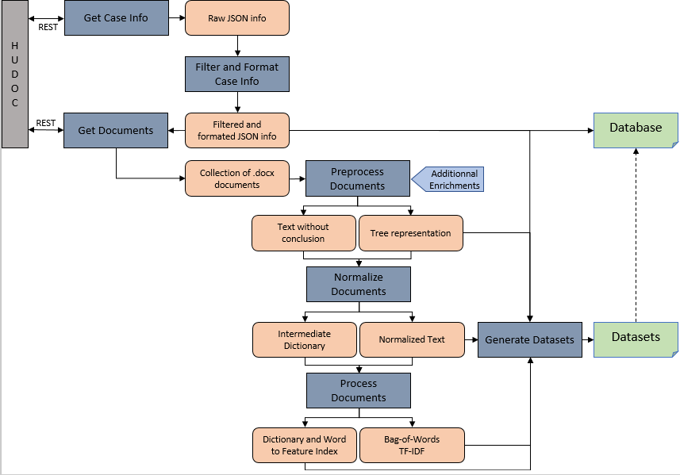
European Court of Human Rights Open Data Project

Slide 49
Article submitted to:
Data Mining and
Knowledge Discovery
(40 points)
Notes:
It seems that what prevents HCBR to obtain good results on adult dataset for instance is the „expressivity” or „model complexity” we defined.

Slide 50
Phase 1. − Prediction
→ Prediction of the ECHR decisions

Slide 51
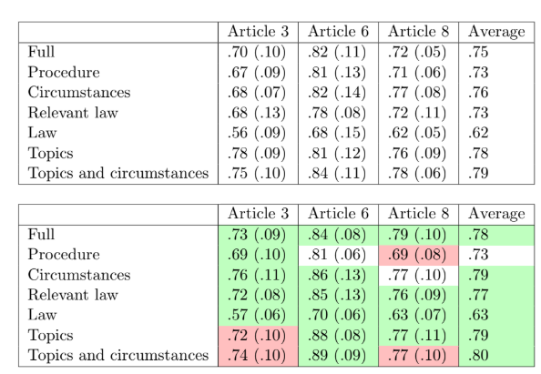
Baseline prediction – Previous study
Ref: Predicting judicial decisions of the European Court of Human Rights: a Natural Language Processing perspective
Nikolaos Aletras​, Dimitrios Tsarapatsanis, Daniel Preoţiuc-Pietro, Vasileios Lampos, October 24, 2016
Notes:
Actually, maybe it does underfit for adult or heart to be honest.

Slide 52
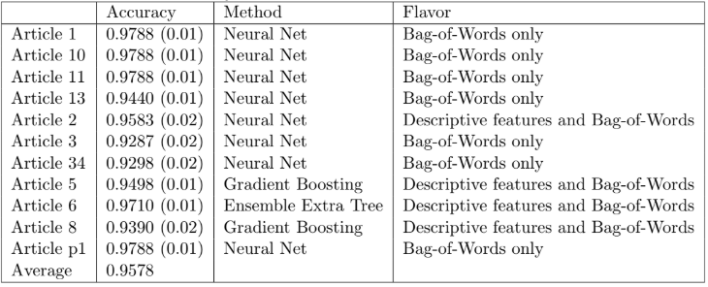
Baseline prediction – ECHR-OD
Notes:
Actually, maybe it does underfit for adult or heart to be honest.

Slide 53
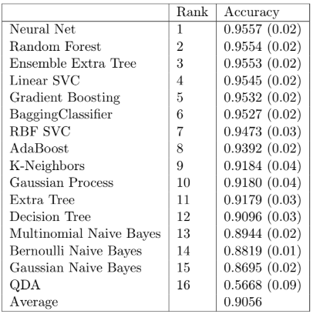
Baseline prediction – ECHR-OD
Notes:
Actually, maybe it does underfit for adult or heart to be honest.

Slide 54
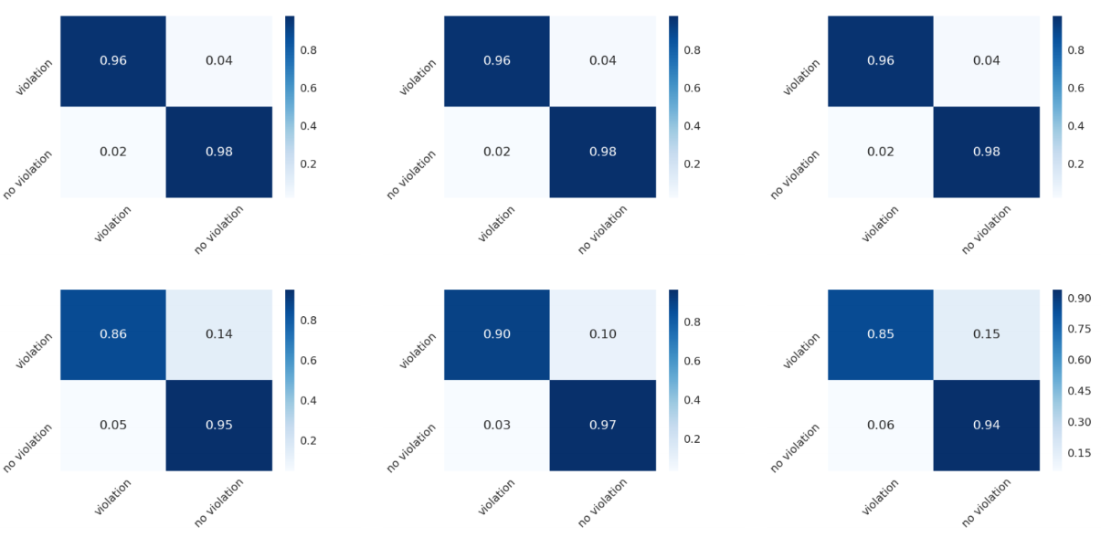
Baseline prediction – ECHR-OD
Notes:
Actually, maybe it does underfit for adult or heart to be honest.

Slide 55
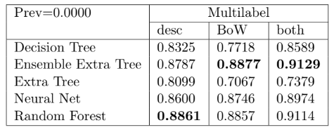
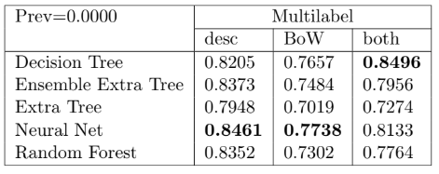
Baseline prediction – ECHR-OD
Accuracy
Precision
Recall
Notes:
Actually, maybe it does underfit for adult or heart to be honest.

Slide 56
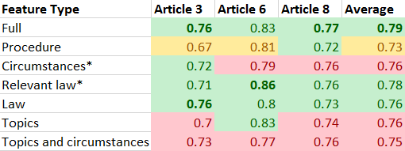
To be done...
HCBR prediction – ECHR-OD
On the small dataset:
On the ECHR-OD datasets
Notes:
Waiting for multilabel and multiclass version + parameter tunning procedure + model space extension

Slide 57
To be done...
HCBR prediction – ECHR-OD
On the small dataset:
On the ECHR-OD datasets
Notes:
Waiting for multilabel and multiclass version + parameter tunning procedure + model space extension

Slide 58
Phase 2. − Justification
→ Direct justification with HCBR

Slide 59
Direct justification with HCBR
CATO [Aleven 1997]: The factor hierarchy is also pre-established by human and divided into 16 abstract factors and 26 base level factors connected by 50 links. CATO uses 8 basic reasoning moves to build a reasoning:
Analogizing a problem to a past case with favorable
Analogizing a problem to a past with an unfavorable outcome
Downplaying the significance of a distinction
Emphasizing the significance of a distinction
Citing a favorable case to highlight strength
Citing a favorable case to argue that weaknesses are not fatal
Citing a more on point counterexample to a case city by an opponent
Citing an as on point counterexample.
Let’s „transfer” those moves to HCBR

Slide 60
Direct justification with HCBR
Justification Tree:
Notes:
There are more particular cases like if one is included in another. I try to enumerate all possible cases.
We are not lawyers, not tactical players, so no cherry picking some cases (probably a limit on the most intersting one)

Slide 61
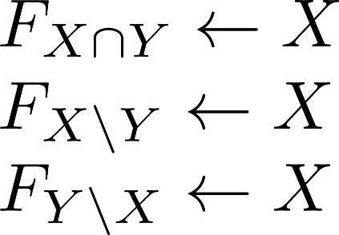
Direct justification with HCBR
Justification Tree:
Easy to interprete
What about ?
What about the cycles?
Impossible or useless
Notes:
There are more particular cases like if one is included in another. I try to enumerate all possible cases.
We are not lawyers, not tactical players, so no cherry picking some cases (probably a limit on the most intersting one)

Slide 62
Phase 2. − Justification
→ Graph reconstruction using HCBR and CSP

Slide 63
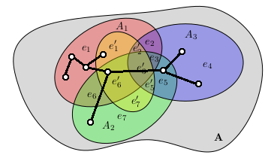
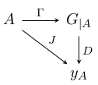
Explanation using graph reconstruction
Problem:
Notes:
D is non monotonic

Slide 64
Explanation using graph reconstruction
Not so easy:
Small problem:
Number of graphs:
Number of subsets:
Additional hypothesis:
Black box estimator:
...
Notes:
Most of classification methods work directly in the feature space, or, when
they modify it, the resulting space inherits the topology of the initial space.
In the particular case of linear models, a scalar product is mandatory to
represent the decision itself and to quantify the distance from an element to
the decision boundary. In some cases, a metric is obviously available, and
in some other cases some ad-hoc metrics may be constructed for a specific
problem.
However, there a plenty of practical situations where the good
metric is not known (e.g. it requires a very specific expertise). Also, it is
very common to miss some data in a dataset (e.g. due to a defective sensor
for some period of time), or to have to include new pieces of information
after an initial model was built (e.g. adding new sensors). In the case of
SVM, for instance in R 3 , if an element has only 2 components it does not
describe a point but a plan and as a result, there is no way separate it with a
(hyper)plan.
Conversely, consider a model built in R 2 with some additional information
available after such that the classification instance now lives in R 3 . Math-
ematically, there is no guarantee that the model in two dimensions is even
close to the model built from scratch in three dimensions. For instance, if the
points are not linearly separable in two dimensions but are in three dimen-
sions, there is no chance for the projection of the plane into the subspace of
two dimensions to be the model found while working only in this subspace.
Despite multiple algorithms have an online counterpart, i.e. the model keeps
being trained with new input vectors, as far as we know, there is no significant
work on having this horizontal scalability (as opposed to vertical scalability).
Of course, exploiting the specificities of features often
6lead to better results but also requires manual expertise that blocks a wider
adoption by end-users. This is particularely true with categorical variables
that often require to be encoded taking into account the method specificity.
For instance, for Decision Tree and its Ensemble counterpart, the Random
Forest, the accuracy depends on the encoder and using a Numerical encoder,
a One-Hot encoder or a Binary encoder may drastically change the model
fitted on the same data. For this reason, it is also important to develop
methods that are “agnostic” to the data representation or at least as less
sensitive as possible.

Slide 65
Explanation using graph reconstruction

Slide 66
Explanation using graph reconstruction
Subject in collaboration with Paweł Mroz (IBM/AGH)!
Heading to

Slide 67
Phase 2. − Justification
→ Generating explanation for the ECHR decisions

Slide 68
Summary

Slide 69
Contributions
Doctoral studies contribution so far:
HCBR: new method for classification in unstructured space
Theory: some bounds and proofs on convergence
Implementation: fast and scalable modern C++ implementation
Data: Largest database and datasets on the ECHR
Domain-specific: Large study on ECHR prediction
To come:
HCBR: Extension to multiclass, multilabel and online version
More HCBR: HCBR on ECHR datasets
Justification: Justification Tree and Graph reconstruction

Slide 70
Thank you
Notes:
Within this demo session we will show how Node.js application can use and display data from previously created model for customer satisfaction prediction.

